Slide 1
Lecture 5
Op Amp – Part 3

Slide 2
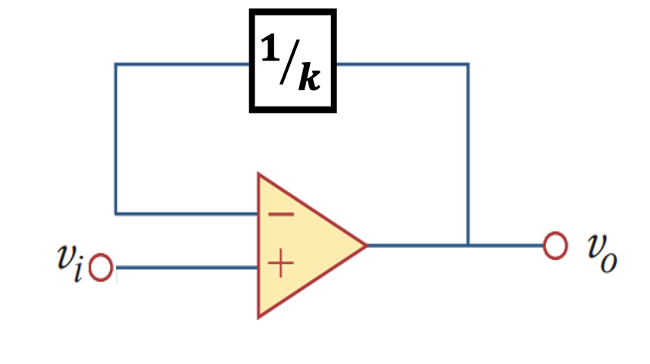
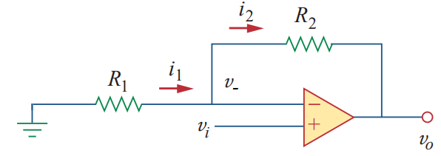
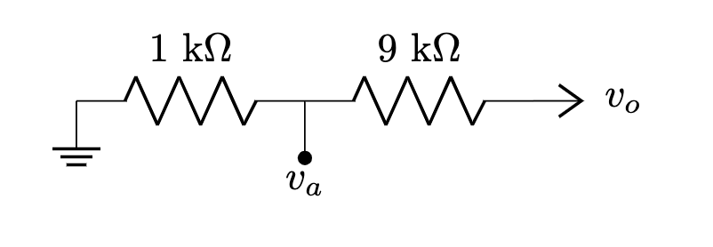

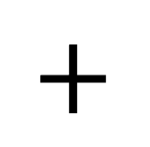
Non-Inverting Amplifier
$$+$$
$$=$$

Slide 3
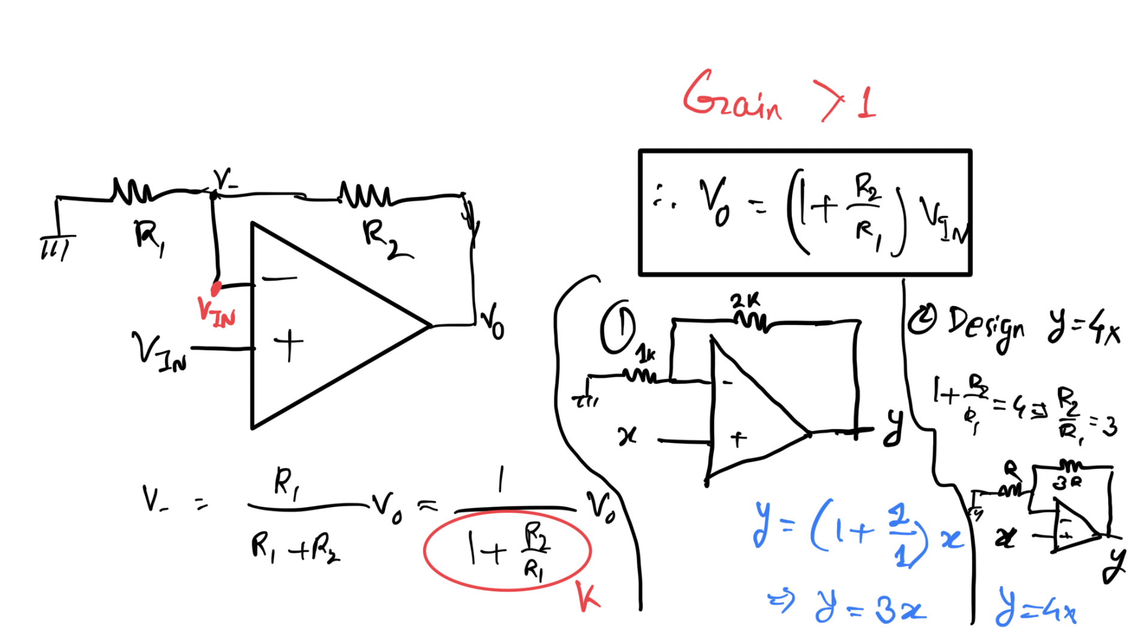
Non-Inverting Amplifier

Slide 4
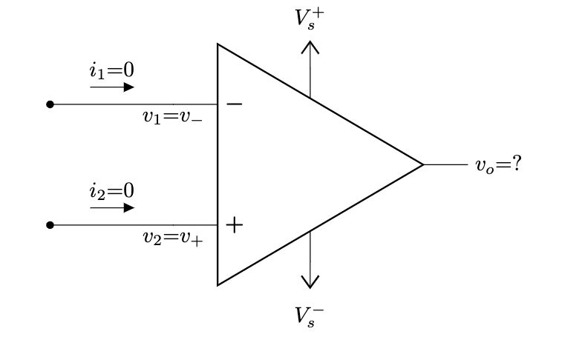
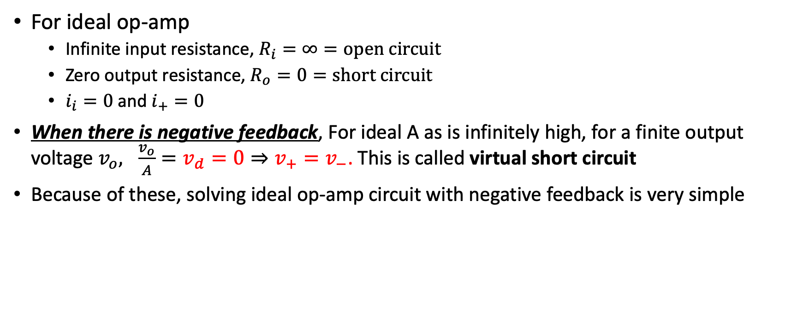
Solving Circuit with Ideal Op Amp + NF
For ideal op-amp
Infinite input resistance, $R_{i}=∞=open circuit$
Zero output resistance, $R_{o}=0=short circuit$
$i_{i}=0$ and $i_{+}=0$
When there is negative feedback, For ideal A as is infinitely high, for a finite output voltage $v_{o}, \frac{v_{o}}{A}={v_{d}=0⇒v}_{+}=v_{−}$. This is called virtual short circuit
Because of these, solving ideal op-amp circuit with negative feedback is very simple

Slide 5
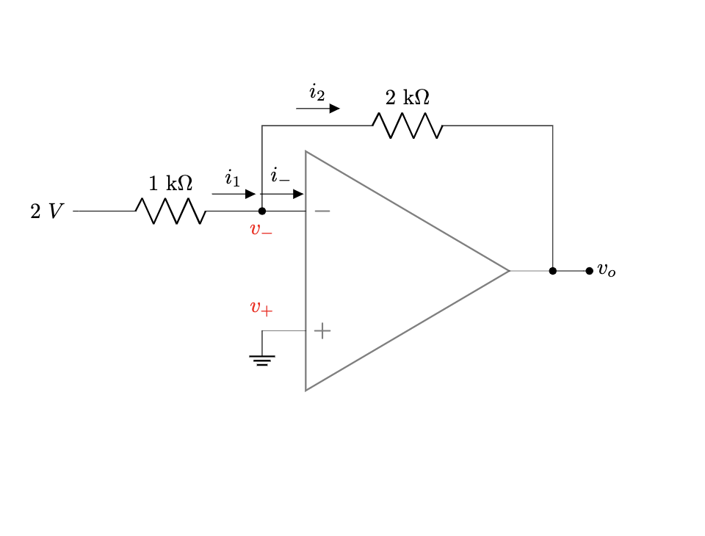
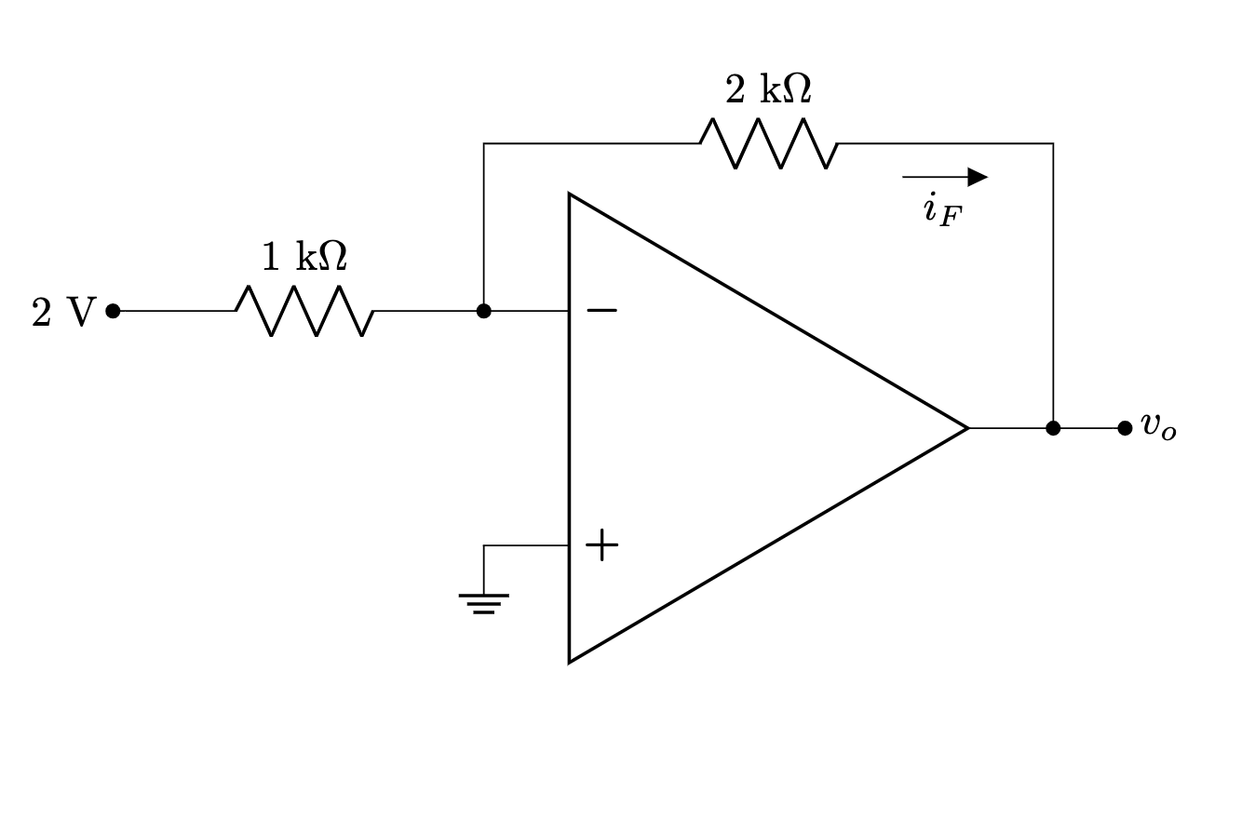
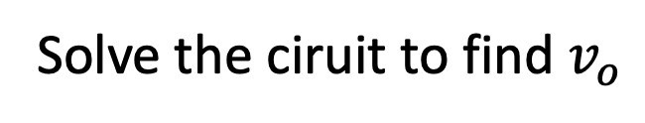
Example – Inverting Amplifier
Solve the ciruit to find $v_{o}$

Slide 6



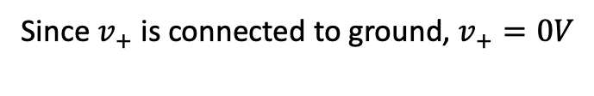

Example – Inverting Amplifier
Since $v_{+}$ is connected to ground, $v_{+}=0V$
Since there is negative feedback, from virtual short, $v_{−}=v_{+}=0V$
Gain = $−\frac{4V}{2V}=−2$ (hence inverting)
From Ohm’s law for $1 kΩ⇒i_{1}=\frac{2V −0V}{1 kΩ}=2mA$
Since ideal op-amp, $i_{−}=i_{+}=0$
From KCL at $v_{−}$, $i_{1}=i_{−}+i_{2}⇒i_{1}=i_{2}=2 mA$
From Ohm’s law for $2 kΩ⇒i_{2}=\frac{v_{−} −v_{0}}{2 kΩ}=2mA⇒v_{o}=−i_{2}×2=−4V$ [Ans]

Slide 7
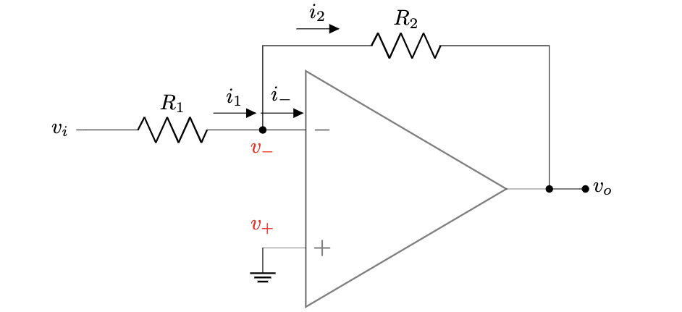


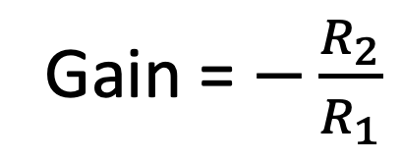
General
Since $v_{+}$ is connected to ground, $v_{+}=0V$
Gain = $−\frac{R_{2}}{R_{1}}$
Since there is negative feedback, from virtual short, $v_{−}=v_{+}=0V$
From Ohm’s law for $R_{1}⇒i_{1}=\frac{v_{i} −0V}{R_{1}}=v_{i}/R_{1}$
Since ideal op-amp, $i_{−}=i_{+}=0$
From KCL at $v_{−}$, $i_{1}=i_{−}+i_{2}⇒i_{1}=i_{2}=v_{i}/R_{1}$
From Ohm’s law for $R_{2}⇒i_{2}=\frac{v_{−} −v_{0}}{R_{2}}=\frac{v_{i}}{R_{1}}⇒v_{o}=−i_{2}×R_{2}⇒v_{o}=−\frac{R_{2}}{R_{1}}v_{i}$ [ANS]

Slide 8
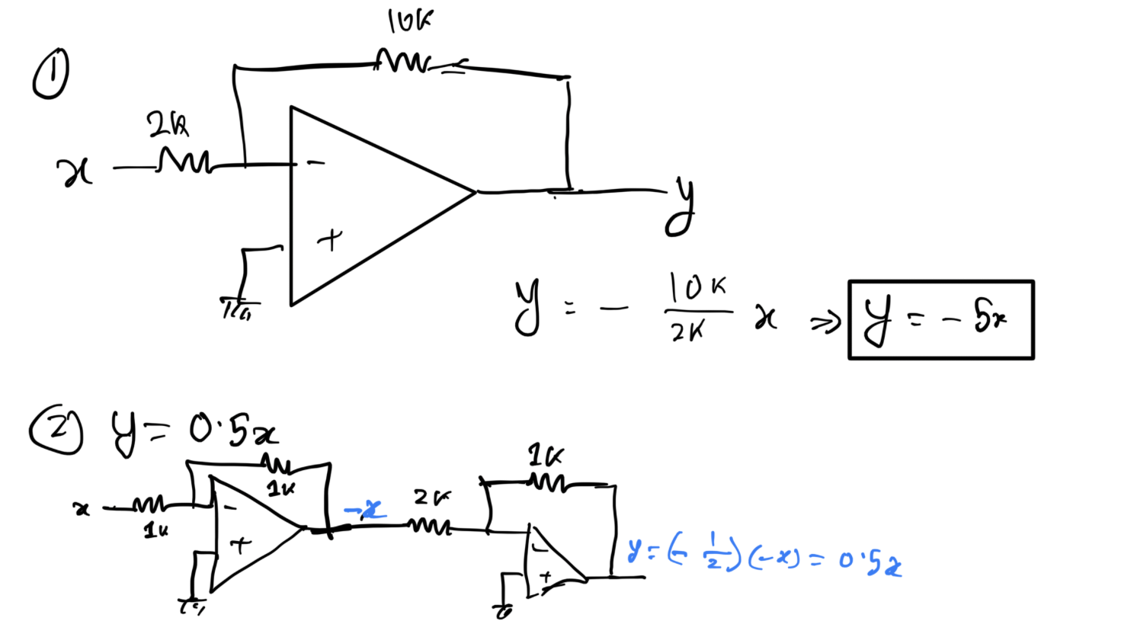
Example

Slide 9
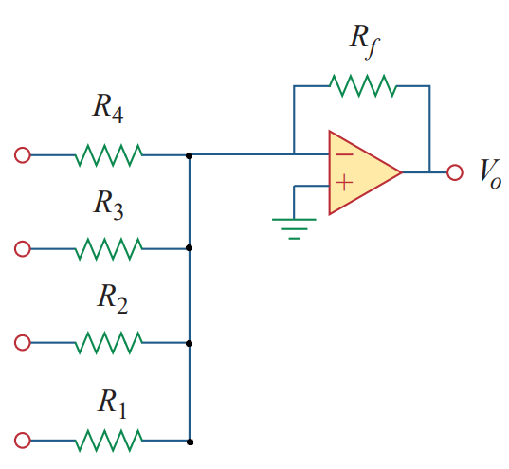
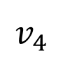
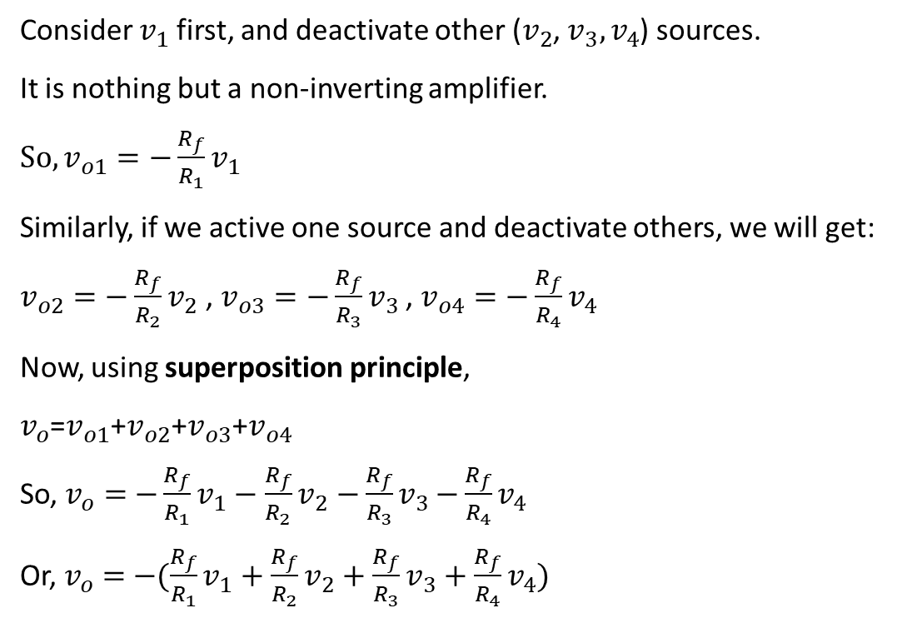
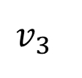
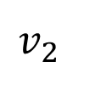
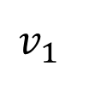
Inverting Adder
Consider $v_{1}$first, and deactivate other ($v_{2}$, $v_{3}{,v}_{4}$) sources.
It is nothing but a non-inverting amplifier.
$So, v_{o1}=−\frac{R_{f}}{R_{1}}v_{1}$
Similarly, if we active one source and deactivate others, we will get:
$v_{o2}=−\frac{R_{f}}{R_{2}}v_{2}$ , $v_{o3}=−\frac{R_{f}}{R_{3}}v_{3}$ , $v_{o4}=−\frac{R_{f}}{R_{4}}v_{4}$
Now, using superposition principle,
$v_{o}$=$v_{o1}$+$v_{o2}$+$v_{o3}$+$v_{o4}$
So, $v_{o}=$ $−\frac{R_{f}}{R_{1}}v_{1}$ $−$ $\frac{R_{f}}{R_{2}}v_{2}$ $−\frac{R_{f}}{R_{3}}v_{3}$ $−\frac{R_{f}}{R_{4}}v_{4}$
Or, $v_{o}=$ $−(\frac{R_{f}}{R_{1}}v_{1}$ $+$ $\frac{R_{f}}{R_{2}}v_{2}+\frac{R_{f}}{R_{3}}v_{3}+\frac{R_{f}}{R_{4}}v_{4})$
$$v_{4}$$
$$v_{3}$$
$$v_{2}$$
$$v_{1}$$
$$We can use this circuit to add any ′n′ number of inputs!$$

Slide 10
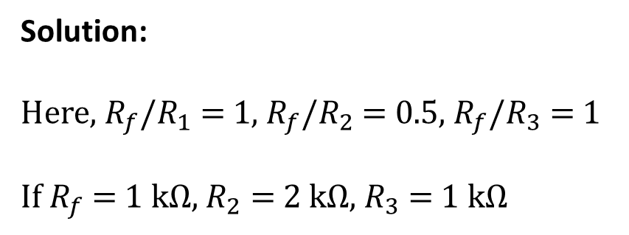
Example
Implement the following function using op-amps:
$$v_{0}=−(v_{1}+0⋅5v_{2}+v_{3})$$
Solution:
Here, $R_{f}$/$R_{1}$ = 1, $R_{f}$/$R_{2}$ = 0.5, $R_{f}$/$R_{3}$ = 1
If $R_{f}$ = 1 kΩ, $R_{2}$ = 2 kΩ, $R_{3}$ = 1 kΩ

Slide 11
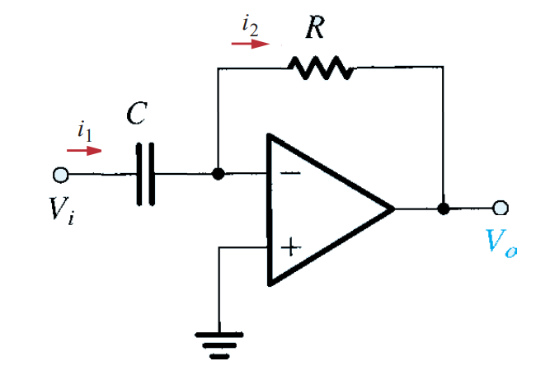
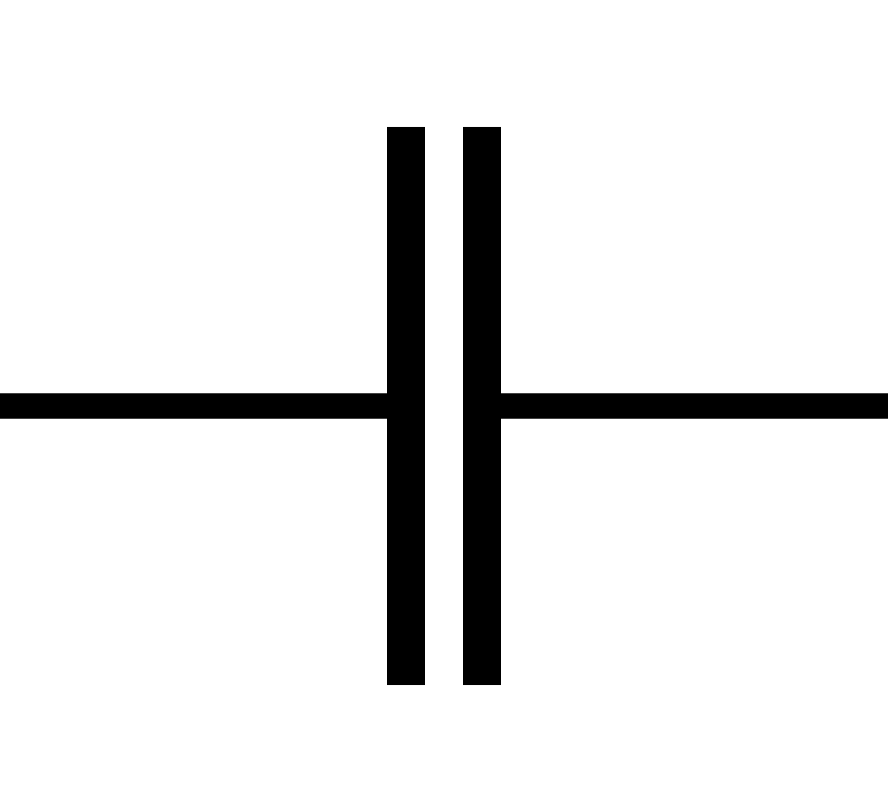
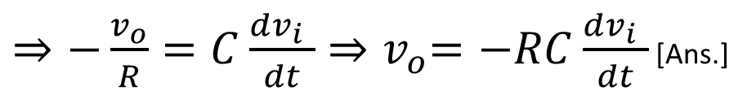



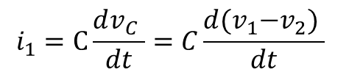






Op Amp as Differentiator
Review – Capacitor
$$i_{1}$$
$$v_{1}$$
$$v_{2}$$
$$+$$
$$−$$
$$v_{C}$$
$$i_{1}=C\frac{dv_{C} }{dt}=C\frac{d{(v}_{1}−v_{2}) }{dt}$$
Since $v_{+}$ is connected to ground, $v_{+}=0V$
Since there is negative feedback, from virtual short, $v_{−}=v_{+}=0V$
For the capacitor C, $⇒i_{1}=C\frac{dv_{C} }{dt}=C\frac{d{(v}_{i}−v_{−}) }{dt}=C\frac{dv_{i} }{dt}$
From Ohm’s law for $R⇒i_{2}=\frac{v_{−} −v_{0}}{R}=−\frac{v_{o}}{R}$
Since ideal op-amp, $i_{−}=i_{+}=0$, so $i_{1}=i_{2}$
$⇒{−\frac{v_{o}}{R}=C\frac{dv_{i} }{dt}⇒v}_{o}=−RC\frac{dv_{i} }{dt}$ [Ans.]

Slide 12
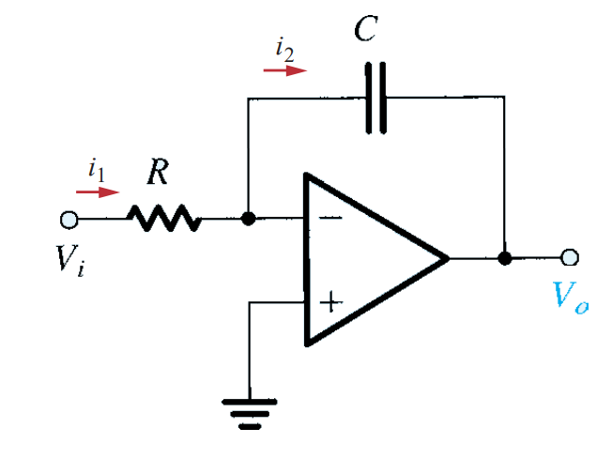

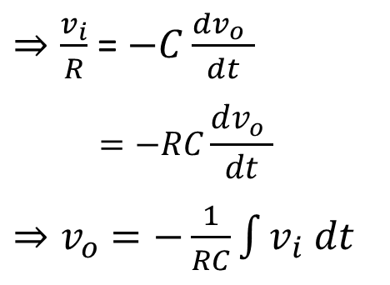


Op Amp as Integrator
Since $v_{+}$ is connected to ground, $v_{+}=0V$
Since there is negative feedback, from virtual short, $v_{−}=v_{+}=0V$
From Ohm’s law for $R⇒i_{1}=\frac{v_{i} −v_{−}}{R}=\frac{v_{i}}{R}$
For the capacitor C, $⇒i_{2}=C\frac{dv_{C} }{dt}=C\frac{d{(v}_{−}−v_{o}) }{dt}=−C\frac{dv_{o} }{dt}$
Since ideal op-amp, $i_{−}=i_{+}=0$, so $i_{1}=i_{2}$
$⇒\frac{v_{i}}{R}$ = $−C\frac{dv_{o} }{dt}$
$$=−RC\frac{dv_{o} }{dt}$$
${⇒v}_{o}$ $=−\frac{1}{RC}\int{v_{i} dt}$

Slide 13
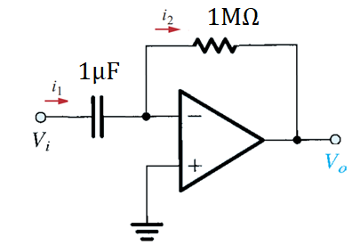
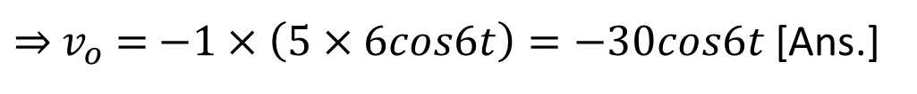
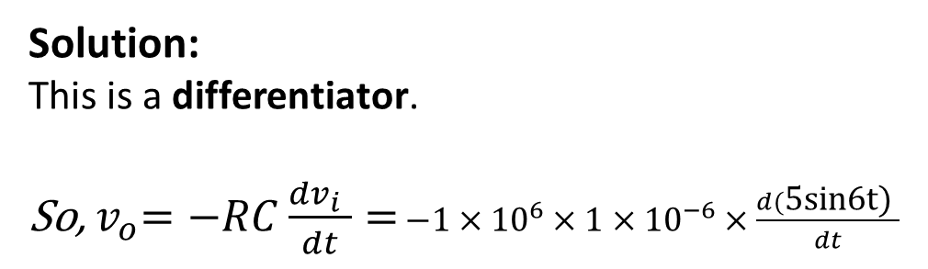
Example
Observe the following Figure. If $v_{i}$= $\text{5}\text{sin}\text{6}\text{t}$, Find the value of $v_{0}$.
Solution:
This is a differentiator.
So,${ v}_{o}=−RC\frac{dv_{i} }{dt}=$ $−1×{10}^{6}×1×{10}^{−6}×\frac{d(\text{5}\text{sin}\text{6}\text{t}\text{)} }{dt}$
$⇒{ v}_{o}$ $=$ $−1×\left(5×6cos6t\right)=−30cos6t$ [Ans.]
Notes:
If time permits,then amplify,minify and differentiator/integrator er comparison dekhabo

Slide 14
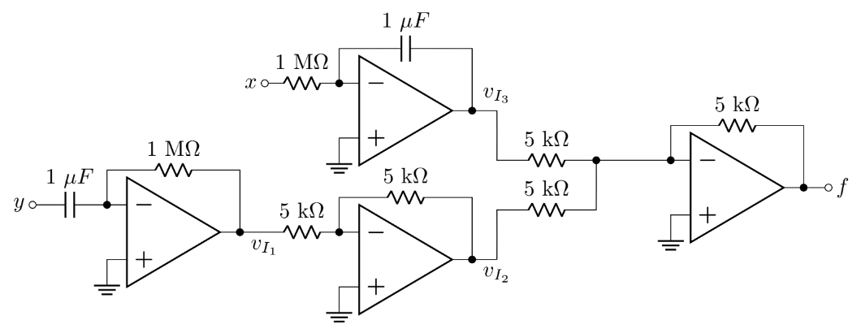
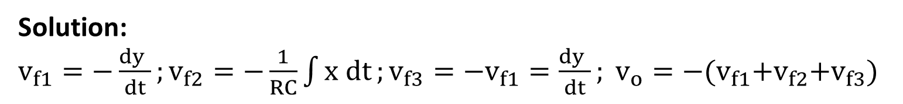
Example
Analyze the circuit below to find an expression of f in terms of inputs x and y.
Solution:
$v_{f1}=−\frac{dy }{dt};v_{f2}=−\frac{1}{RC}\int{x dt};v_{f3}=−v_{f1}=\frac{dy }{dt}; {v_{o}=−(v}_{f1}$+$v_{f2}$+$v_{f3}$)

Slide 15
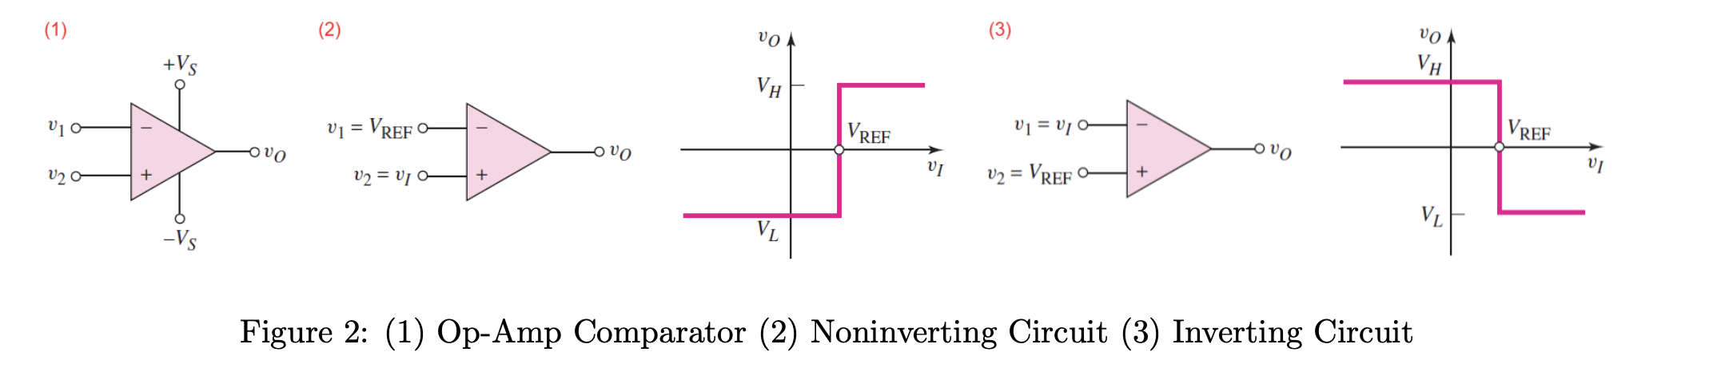
Op Amp as Comparator
A comparator compares two voltages to determine which is larger.

